Slide 1


Boundless Lecture Slides
Available on the Boundless Teaching Platform
Free to share, print, make copies and changes. Get yours at www.boundless.com

Slide 2
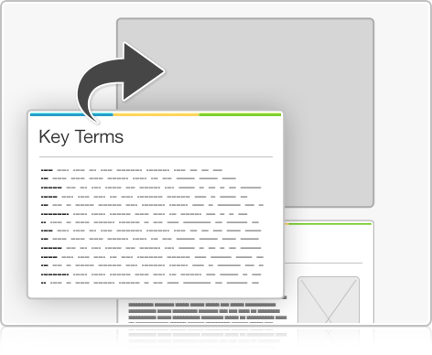


Using Boundless Presentations
Boundless Teaching Platform
Boundless empowers educators to engage their students with affordable, customizable textbooks and intuitive teaching tools. The free Boundless Teaching Platform gives educators the ability to customize textbooks in more than 20 subjects that align to hundreds of popular titles. Get started by using high quality Boundless books, or make switching to our platform easier by building from Boundless content pre-organized to match the assigned textbook. This platform gives educators the tools they need to assign readings and assessments, monitor student activity, and lead their classes with pre-made teaching resources.
Get started now at:
The Appendix
The appendix is for you to use to add depth and breadth to your lectures. You can simply drag and drop slides from the appendix into the main presentation to make for a richer lecture experience.
http://boundless.com/teaching-platform
Free to edit, share, and copy
Feel free to edit, share, and make as many copies of the Boundless presentations as you like. We encourage you to take these presentations and make them your own.
If you have any questions or problems please email:
educators@boundless.com
Free to share, print, make copies and changes. Get yours at www.boundless.com

Slide 3

About Boundless
Boundless is an innovative technology company making education more affordable and accessible for students everywhere. The company creates the world’s best open educational content in 20+ subjects that align to more than 1,000 popular college textbooks. Boundless integrates learning technology into all its premium books to help students study more efficiently at a fraction of the cost of traditional textbooks. The company also empowers educators to engage their students more effectively through customizable books and intuitive teaching tools as part of the Boundless Teaching Platform. More than 2 million learners access Boundless free and premium content each month across the company’s wide distribution platforms, including its website, iOS apps, Kindle books, and iBooks. To get started learning or teaching with Boundless, visit boundless.com.
Free to share, print, make copies and changes. Get yours at www.boundless.com

Slide 4
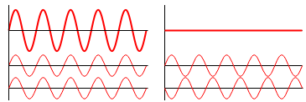
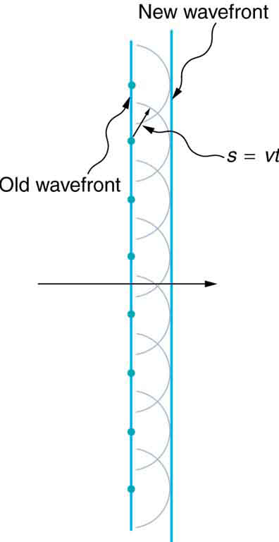
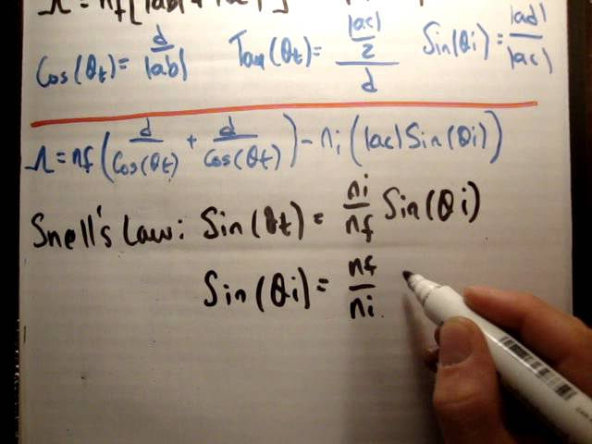

Wave Optics
Superposition and Interference
Diffraction
Further Topics
Applications of Wave Optics
]
Wave Optics
Free to share, print, make copies and changes. Get yours at www.boundless.com

Slide 5

Superposition and Interference
Wave Optics > Superposition and Interference
Conditions for Wave Interference: Reflection due to Phase Change
Air Wedge
Newton's Rings
Free to share, print, make copies and changes. Get yours at www.boundless.com
www.boundless.com/physics/textbooks/boundless-physics-textbook/wave-optics-26/superposition-and-interference-174/

Slide 6
Diffraction
Wave Optics > Diffraction
Huygens' Principle
Young's Double Slit Experiment
Diffraction Gratings: X-Ray, Grating, Reflection
Single Slit Diffraction
The Rayleigh Criterion
Free to share, print, make copies and changes. Get yours at www.boundless.com
www.boundless.com/physics/textbooks/boundless-physics-textbook/wave-optics-26/diffraction-175/

Slide 7
Further Topics
Wave Optics > Further Topics
Thin Film Interference
Polarization By Passing Light Through Polarizers
Polarization By Scattering and Reflecting
Scattering of Light by the Atmosphere
Dispersion of the Visible Spectrum
Free to share, print, make copies and changes. Get yours at www.boundless.com
www.boundless.com/physics/textbooks/boundless-physics-textbook/wave-optics-26/further-topics-176/

Slide 8
Applications of Wave Optics
Wave Optics > Applications of Wave Optics
Enhancement of Microscopy
The Spectrometer
The Michelson Interferometer
LCDs
Using Interference to Read CDs and DVDs
Free to share, print, make copies and changes. Get yours at www.boundless.com
www.boundless.com/physics/textbooks/boundless-physics-textbook/wave-optics-26/applications-of-wave-optics-177/

Slide 9
Appendix
Free to share, print, make copies and changes. Get yours at www.boundless.com

Slide 10
Key terms
Wave Optics
binary data Data which can take on only two possible values, traditionally termed 0 and 1.
coherent Of waves having the same direction, wavelength and phase, as light in a laser.
constructive interference Occurs when waves interfere with each other crest to crest and the waves are exactly in phase with each other.
contrast A difference in lightness, brightness and/or hue between two colors that makes them more or less distinguishable
destructive interference Occurs when waves interfere with each other crest to trough (peak to valley) and are exactly out of phase with each other.
diffraction The bending of a wave around the edges of an opening or an obstacle.
diffraction The bending of a wave around the edges of an opening or an obstacle.
diffraction The bending of a wave around the edges of an opening or an obstacle.
diffraction The bending of a wave around the edges of an opening or an obstacle.
dispersion The separation of visible light by refraction or diffraction.
electromagnetic radiation radiation (quantized as photons) consisting of oscillating electric and magnetic fields oriented perpendicularly to each other, moving through space
helical In the shape of a helix, twist.
Free to share, print, make copies and changes. Get yours at www.boundless.com

Slide 11
Wave Optics
incandescence Incandescence is the emission of light (visible electromagnetic radiation) from a hot body as a result of its temperature.
incident ray The ray of light that strikes the surface.
index of refraction For a material, the ratio of the speed of light in vacuum to that in the material.
interference An effect caused by the superposition of two systems of waves, such as a distortion on a broadcast signal due to atmospheric or other effects.
interference An effect caused by the superposition of two systems of waves, such as a distortion on a broadcast signal due to atmospheric or other effects.
interference An effect caused by the superposition of two systems of waves, such as a distortion on a broadcast signal due to atmospheric or other effects.
interferometer Any of several instruments that use the interference of waves to determine wavelengths and wave velocities, determine refractive indices, and measure small distances, temperature changes, stresses, and many other useful measurements.
iridescence The condition or state of being iridescent; exhibition of colors like those of the rainbow; a prismatic play of color.
land A flat area on an optical disc that reflects light when illuminated.
LCD a liquid crystal display.
lens an object, usually made of glass, that focuses or defocuses the light that passes through it
microscopy using microscopes to view objects that cannot be seen with the naked eye
Free to share, print, make copies and changes. Get yours at www.boundless.com

Slide 12
Wave Optics
monochromatic Describes a beam of light with a single wavelength (i.e., of one specific color or frequency).
monochromatic Describes a beam of light with a single wavelength (i.e., of one specific color or frequency).
nematic Describing the structure of some liquid crystals whose molecules align in loose parallel lines.
orthogonal Of two objects, at right angles; perpendicular to each other.
oscillate To swing back and forth, especially if with a regular rhythm.
pit An imprint on an optical disc that scatters light when illuminated.
plane wave A constant-frequency wave whose wavefronts (surfaces of constant phase) are infinite parallel planes of constant peak-to-peak amplitude normal to the phase velocity vector.
polarizability The relative tendency of a system of electric charges to become polarized in the presence of an external electric field
polarization The production of polarized light; the direction in which the electric field of an electromagnetic wave points.
reflection the property of a propagated wave being thrown back from a surface (such as a mirror)
refraction Changing of a light ray's direction when it passes through variations in matter.
resolution The degree of fineness with which an image can be recorded or produced, often expressed as the number of pixels per unit of length (typically an inch).
Free to share, print, make copies and changes. Get yours at www.boundless.com

Slide 13
Wave Optics
special relativity A theory that (neglecting the effects of gravity) reconciles the principle of relativity with the observation that the speed of light is constant in all frames of reference.
superimposed Positioned on or above something else, especially in layers
wavelength The length of a single cycle of a wave, as measured by the distance between one peak or trough of a wave and the next; it is often designated in physics as λ, and corresponds to the velocity of the wave divided by its frequency.
wavelength The length of a single cycle of a wave, as measured by the distance between one peak or trough of a wave and the next; it is often designated in physics as λ, and corresponds to the velocity of the wave divided by its frequency.
Free to share, print, make copies and changes. Get yours at www.boundless.com

Slide 14
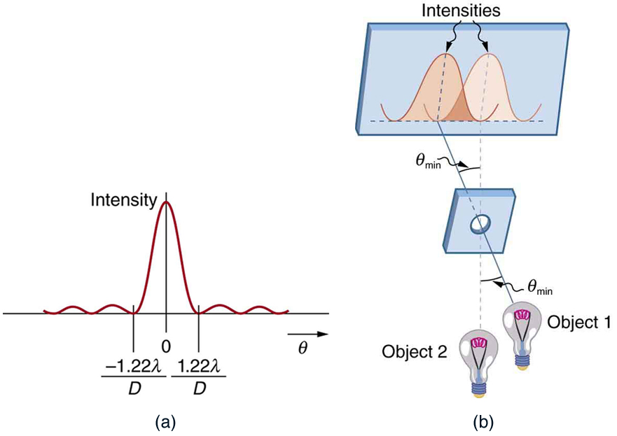
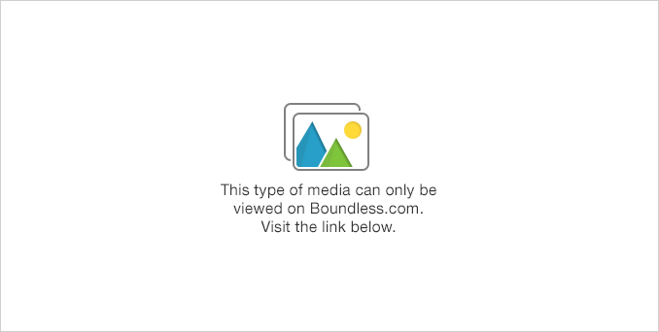
Wave Optics
Rayleigh Criterion
(a) This is a graph of intensity of the diffraction pattern for a circular aperture. Note that, similar to a single slit, the central maximum is wider and brighter than those to the sides. (b) Two point objects produce overlapping diffraction patterns. Shown here is the Rayleigh criterion for being just resolvable. The central maximum of one pattern lies on the first minimum of the other.
Free to share, print, make copies and changes. Get yours at www.boundless.com
OpenStax CNX. "OpenStax College, Limits of Resolution: The Rayleigh Criterion. January 12, 2013." CC BY 3.0 http://cnx.org/content/m42517/latest/ View on Boundless.com

Slide 15
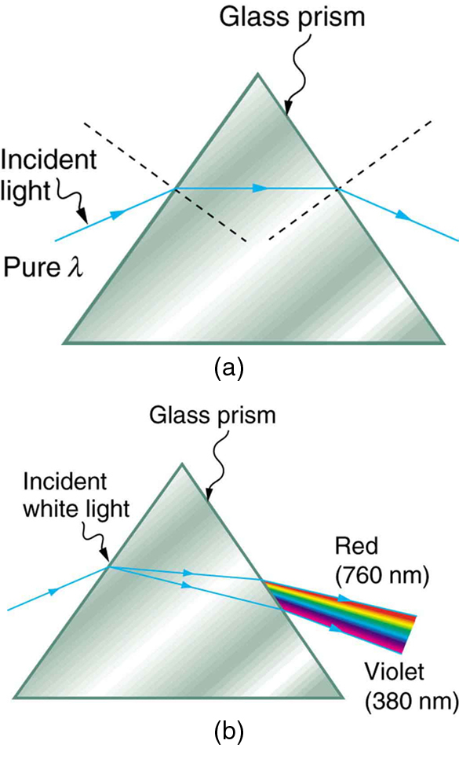
Wave Optics
Light and a Glass Prism
(a) A pure wavelength of light falls onto a prism and is refracted at both surfaces. (b) White light is dispersed by the prism (shown exaggerated). Since the index of refraction varies with wavelength, the angles of refraction vary with wavelength. A sequence of red to violet is produced, because the index of refraction increases steadily with decreasing wavelength.
Free to share, print, make copies and changes. Get yours at www.boundless.com
OpenStax CNX. "OpenStax College, Dispersion: The Rainbow and Prisms. January 13, 2013." CC BY 3.0 http://cnx.org/content/m42466/latest/ View on Boundless.com

Slide 16
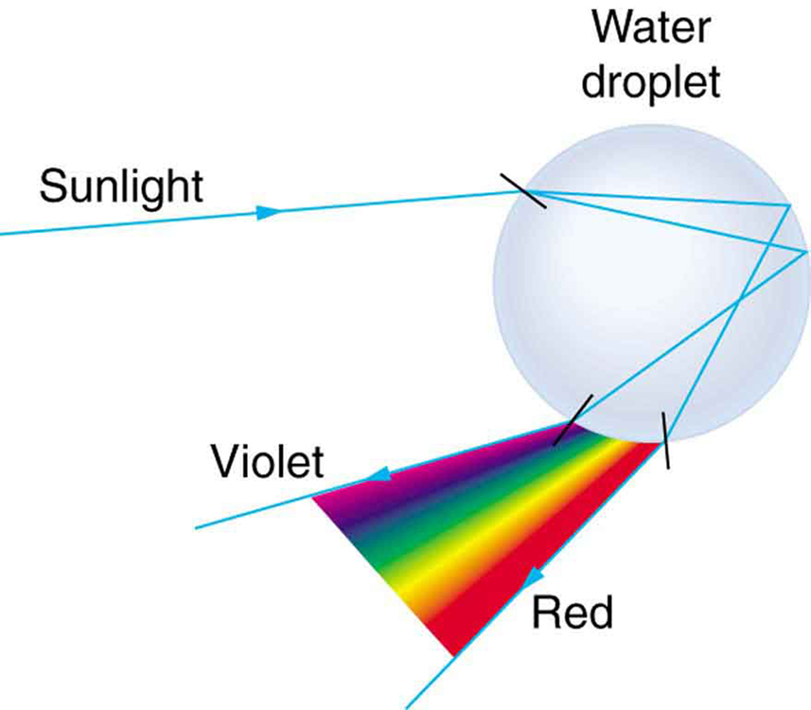
Wave Optics
Light and a Water Droplet
Part of the light falling on this water drop enters and is reflected from the back of the drop. This light is refracted and dispersed both as it enters and as it leaves the drop.
Free to share, print, make copies and changes. Get yours at www.boundless.com
OpenStax CNX. "OpenStax College, Dispersion: The Rainbow and Prisms. January 13, 2013." CC BY 3.0 http://cnx.org/content/m42466/latest/ View on Boundless.com

Slide 17
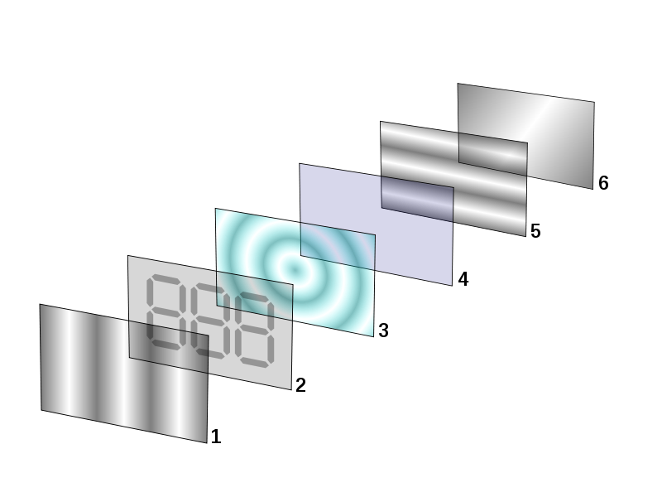
Wave Optics
Layers of LCD Displays
Polarizing filter film with a vertical axis to polarize light as it enters.Glass substrate with ITO electrodes. The shapes of these electrodes will determine the shapes that will appear when the LCD is turned on. Vertical ridges etched on the surface are smooth.Twisted nematic liquid crystal.Glass substrate with common electrode film (ITO) with horizontal ridges to line up with the horizontal filter.Polarizing filter film with a horizontal axis to block/pass light.Reflective surface to send light back to viewer. (In a backlit LCD, this layer is replaced with a light source. )
Free to share, print, make copies and changes. Get yours at www.boundless.com
Wikipedia. "LCD layers." CC BY-SA http://en.wikipedia.org/wiki/File:LCD_layers.svg View on Boundless.com

Slide 18
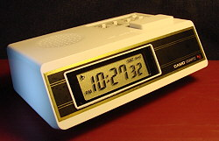
Wave Optics
Digital Clock
A digital clock which uses LCD to either hide or display fixed images.
Free to share, print, make copies and changes. Get yours at www.boundless.com
Wikipedia. "MA-2." Public domain http://en.wikipedia.org/wiki/File:MA-2.JPG View on Boundless.com

Slide 19
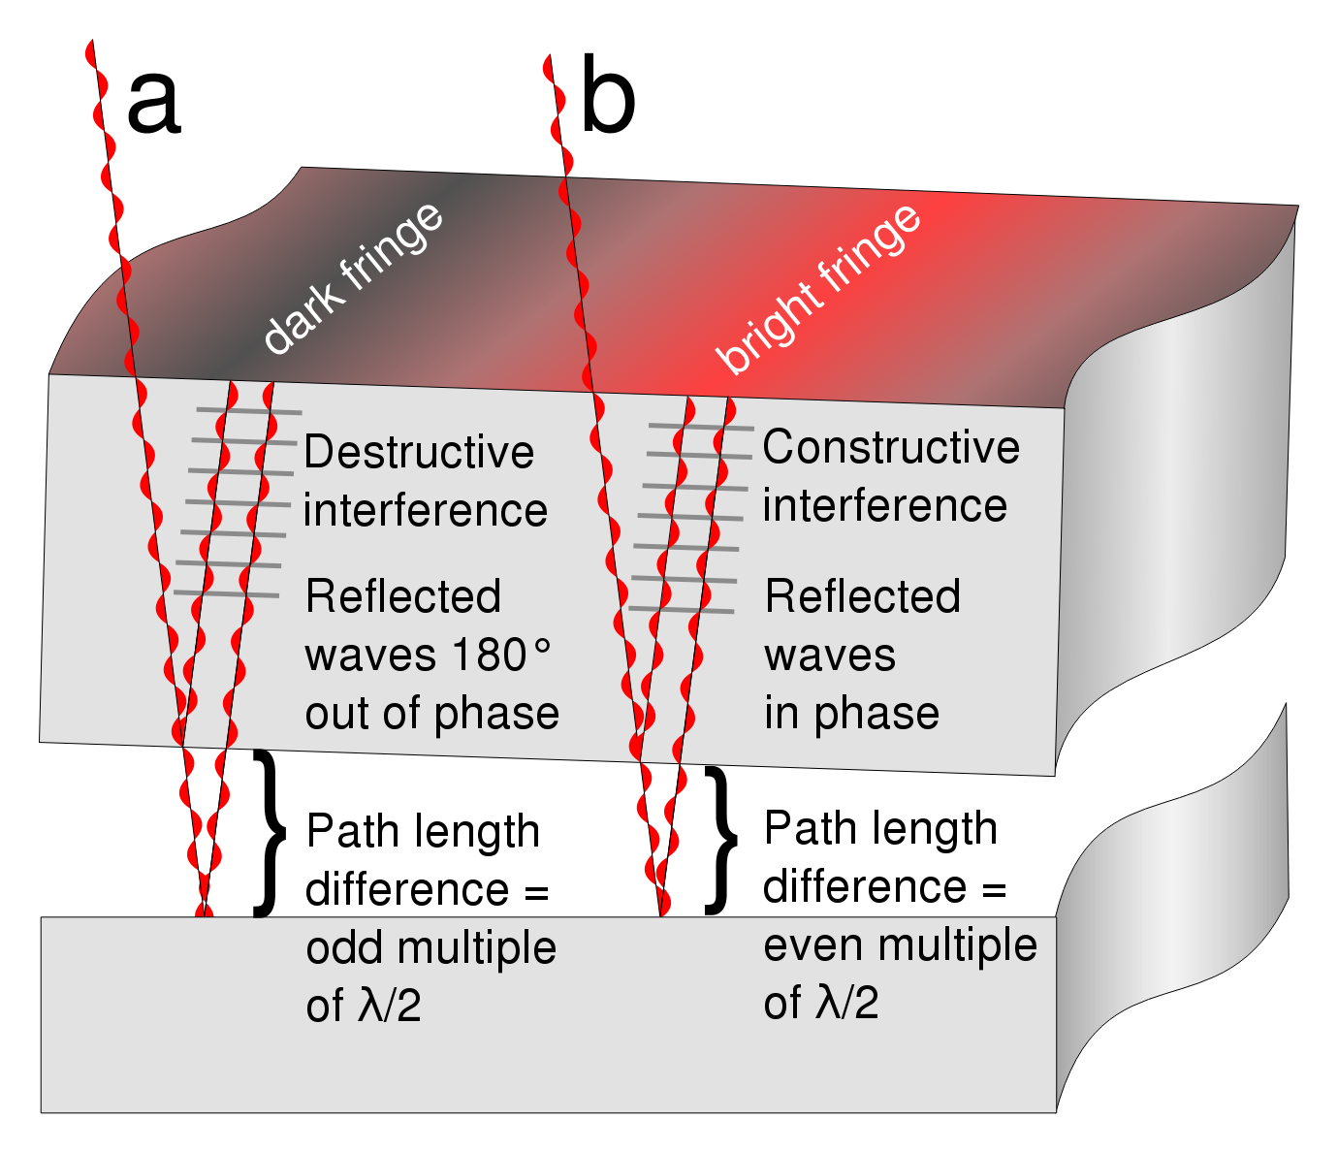
Wave Optics
Formation of Interference Fringes
This figure shows how interference fringes form.
Free to share, print, make copies and changes. Get yours at www.boundless.com
Wikipedia. "Newton's rings." GNU FDL http://en.wikipedia.org/wiki/Newton's_rings View on Boundless.com

Slide 20
Wave Optics
Wave Interference
Examples of constructive (left) and destructive (right) wave interference.
Free to share, print, make copies and changes. Get yours at www.boundless.com
Wikipedia. "Interference (wave propagation)." GNU FDL http://en.wikipedia.org/wiki/Interference_(wave_propagation) View on Boundless.com

Slide 21
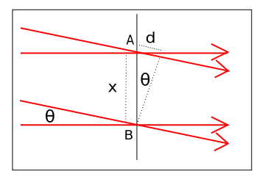
Wave Optics
Interference of Plane Waves
Geometrical arrangement for two plane wave interference.
Free to share, print, make copies and changes. Get yours at www.boundless.com
Wikipedia. "Interference (wave propagation)." GNU FDL http://en.wikipedia.org/wiki/Interference_(wave_propagation) View on Boundless.com

Slide 22
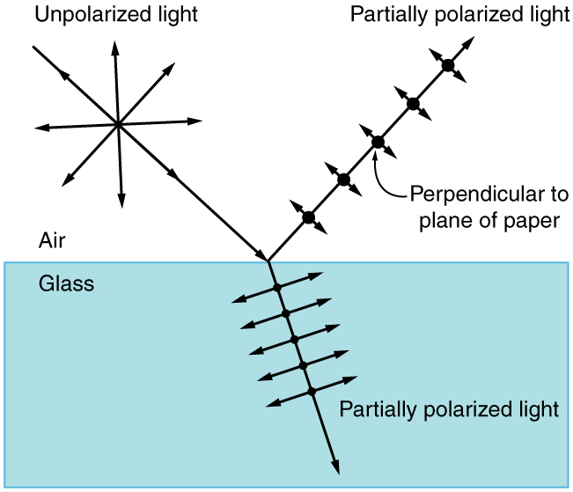
Wave Optics
Polarization by Reflection
Unpolarized light has equal amounts of vertical and horizontal polarization. After interaction with a surface, the vertical components are preferentially absorbed or refracted, leaving the reflected light more horizontally polarized. This is akin to arrows striking on their sides bouncing off, whereas arrows striking on their tips go into the surface.
Free to share, print, make copies and changes. Get yours at www.boundless.com
OpenStax CNX. "OpenStax College, Polarization. January 13, 2013." CC BY 3.0 http://cnx.org/content/m42522/latest/ View on Boundless.com

Slide 23
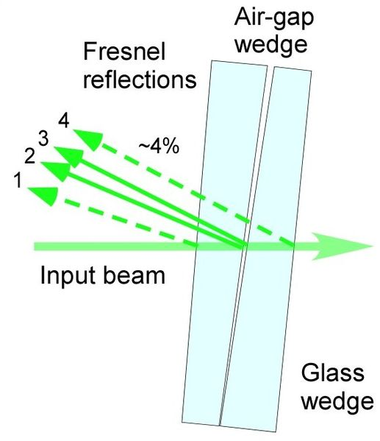
Wave Optics
Light Reflections Inside an Air Wedge Interferometer
Beam path inside of air wedge interferometer
Free to share, print, make copies and changes. Get yours at www.boundless.com
Wikipedia. "Air-wedge shearing interferometer." GNU FDL http://en.wikipedia.org/wiki/Air-wedge_shearing_interferometer View on Boundless.com

Slide 24
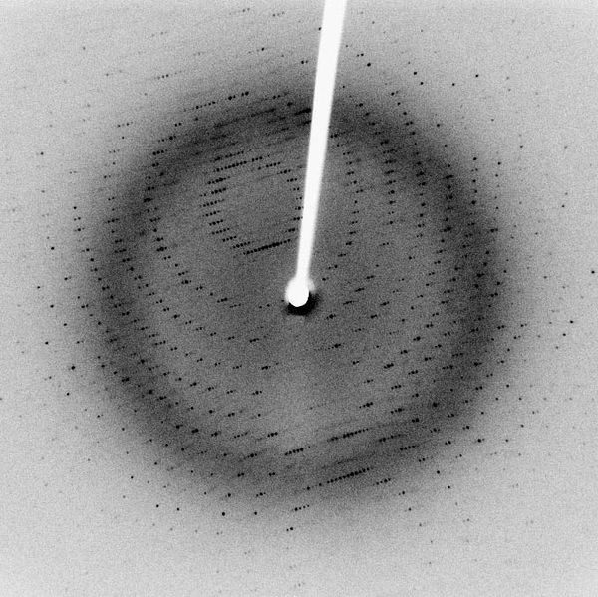
Wave Optics
Reflections in Diffraction Patterns
Each dot, called a reflection, in this diffraction pattern forms from the constructive interference of scattered X-rays passing through a crystal. The data can be used to determine the crystalline structure.
Free to share, print, make copies and changes. Get yours at www.boundless.com
Wikipedia. "X-ray diffraction pattern 3clpro." CC BY-SA http://en.wikipedia.org/wiki/File:X-ray_diffraction_pattern_3clpro.jpg View on Boundless.com

Slide 25
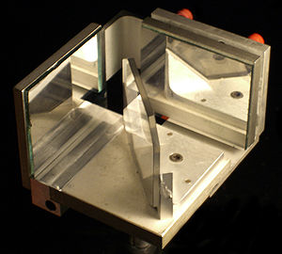
Wave Optics
Michelson Interferometer
A Michelson Interferometer.
Free to share, print, make copies and changes. Get yours at www.boundless.com
Wikipedia. "Michelson Interferometer." CC BY-SA http://en.wikipedia.org/wiki/File:Michelson_Interferometer.jpg View on Boundless.com

Slide 26
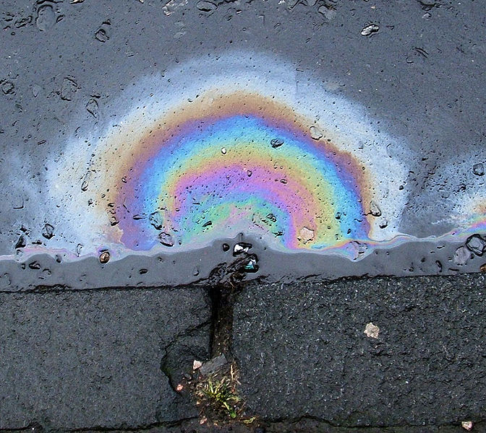
Wave Optics
Thin Film Interference in Oil
Thin film interference can be seen in this oil slick.
Free to share, print, make copies and changes. Get yours at www.boundless.com
Wikipedia. "Dieselrainbow." CC BY-SA http://en.wikipedia.org/wiki/File:Dieselrainbow.jpg View on Boundless.com

Slide 27
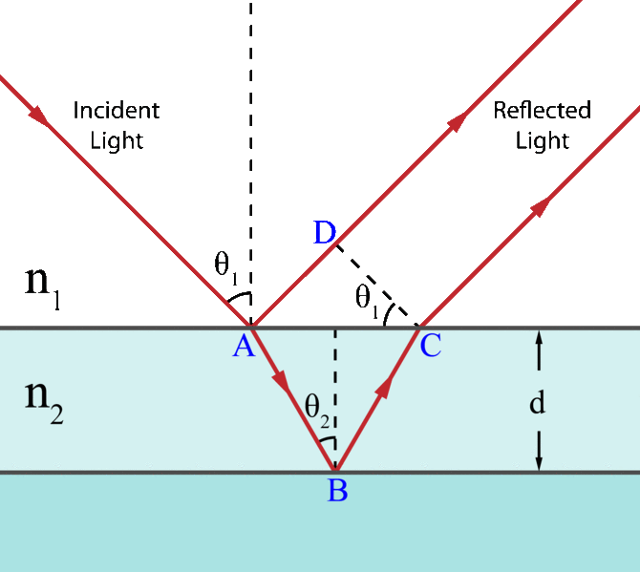
Wave Optics
Light on a Thin Film
Light incident on a thin film. Demonstration of the optical path length difference for light reflected from the upper and lower boundaries.
Free to share, print, make copies and changes. Get yours at www.boundless.com
Wikimedia. CC BY-SA http://upload.wikimedia.org/wikipedia/en/thumb/f/f1/Thin_film_interference.gif/670px-Thin_film_interference.gif View on Boundless.com

Slide 28
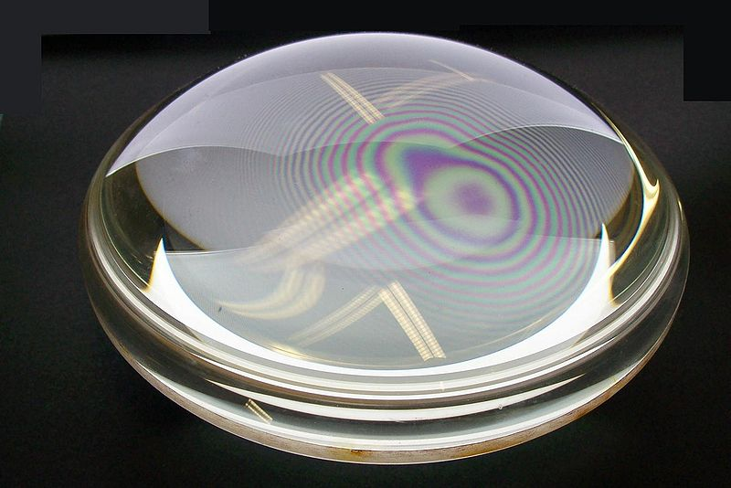
Wave Optics
Newton's Rings in a drop of water
Newton's rings seen in two plano-convex lenses with their flat surfaces in contact. One surface is slightly convex, creating the rings. In white light, the rings are rainbow-colored, because the different wavelengths of each color interfere at different locations.
Free to share, print, make copies and changes. Get yours at www.boundless.com
Wikipedia. "Newton's rings." Public domain http://en.wikipedia.org/wiki/Newton's_rings View on Boundless.com

Slide 29
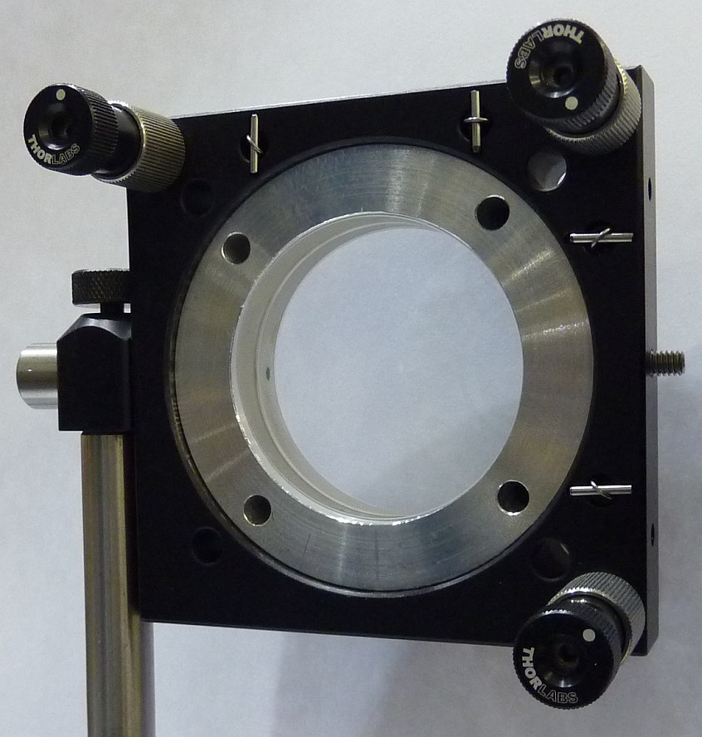
Wave Optics
Air Wedge
Example of air wedge interferometer
Free to share, print, make copies and changes. Get yours at www.boundless.com
Wikipedia. "Air-wedge shearing interferometer." GNU FDL http://en.wikipedia.org/wiki/Air-wedge_shearing_interferometer View on Boundless.com

Slide 30
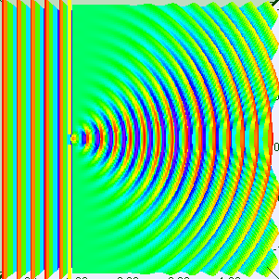
Wave Optics
Single Slit Diffraction - One Wavelength
Visualization of single slit diffraction when the slit is equal to one wavelength.
Free to share, print, make copies and changes. Get yours at www.boundless.com
Wikipedia. "Wavelength=slitwidthspectrum." CC BY-SA http://en.wikipedia.org/wiki/File:Wavelength=slitwidthspectrum.gif View on Boundless.com

Slide 31
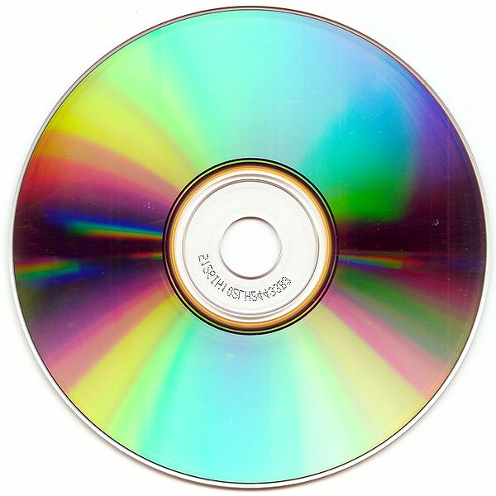
Wave Optics
Compact Disc
The bottom surface of a compact disc showing characteristic iridescence.
Free to share, print, make copies and changes. Get yours at www.boundless.com
Wikipedia. "CD autolev crop." CC BY-SA http://en.wikipedia.org/wiki/File:CD_autolev_crop.jpg View on Boundless.com

Slide 32
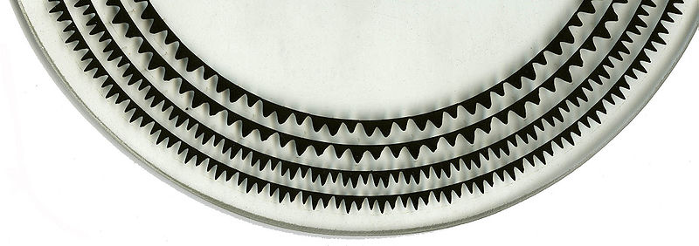
Wave Optics
Early Version of an Optical Disc
In this early version of an optical disc, you can see the pits and lands which either reflect back light or scatter it.
Free to share, print, make copies and changes. Get yours at www.boundless.com
Wikipedia. "Lichttonorgelversuchsscheibe." CC BY-SA http://en.wikipedia.org/wiki/File:Lichttonorgelversuchsscheibe.jpg View on Boundless.com

Slide 33
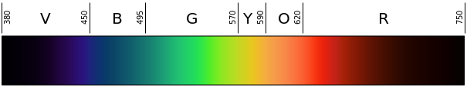
Wave Optics
The Visible Spectrum
Visible Spectrum, represented linearly
Free to share, print, make copies and changes. Get yours at www.boundless.com
Wikipedia. "Linear visible spectrum." Public domain http://en.wikipedia.org/wiki/File:Linear_visible_spectrum.svg View on Boundless.com

Slide 34
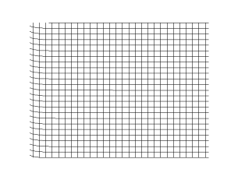
Wave Optics
Figure 1
Transverse Waves
Free to share, print, make copies and changes. Get yours at www.boundless.com
Wikipedia. "Onde cisaillement impulsion 1d 30 petit." CC BY-SA http://en.wikipedia.org/wiki/File:Onde_cisaillement_impulsion_1d_30_petit.gif View on Boundless.com

Slide 35
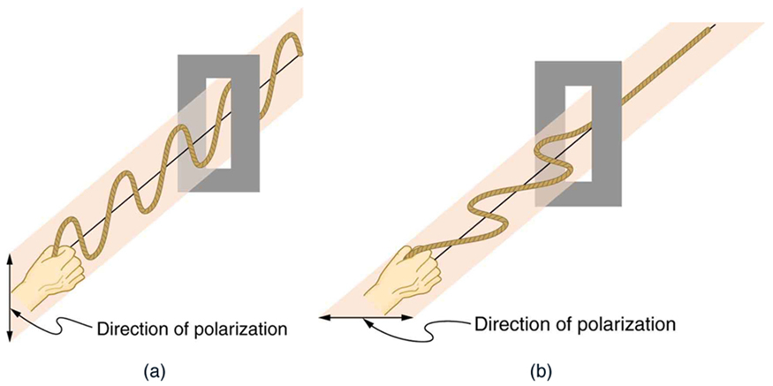
Wave Optics
Figure 3
Example of passing light through a polarizer
Free to share, print, make copies and changes. Get yours at www.boundless.com
OpenStax CNX. "OpenStax College, Polarization. January 13, 2013." CC BY 3.0 http://cnx.org/content/m42522/latest/ View on Boundless.com

Slide 36
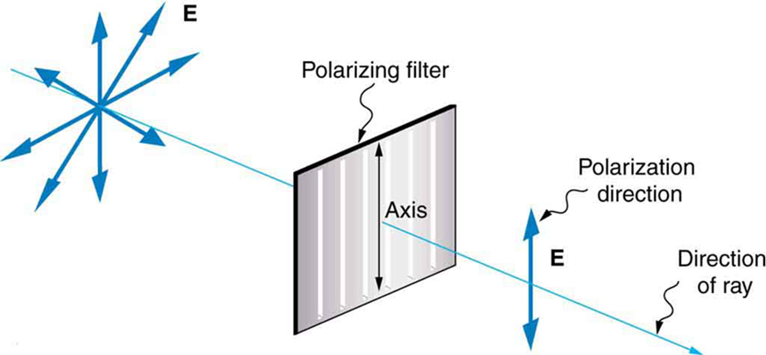
Wave Optics
Figure 5
A polarizing filter has a polarization axis that acts as a slit passing through electric fields parallel to its direction. The direction of polarization of an EM wave is defined to be the direction of its electric field.
Free to share, print, make copies and changes. Get yours at www.boundless.com
OpenStax CNX. "OpenStax College, Polarization. January 13, 2013." CC BY 3.0 http://cnx.org/content/m42522/latest/ View on Boundless.com

Slide 37
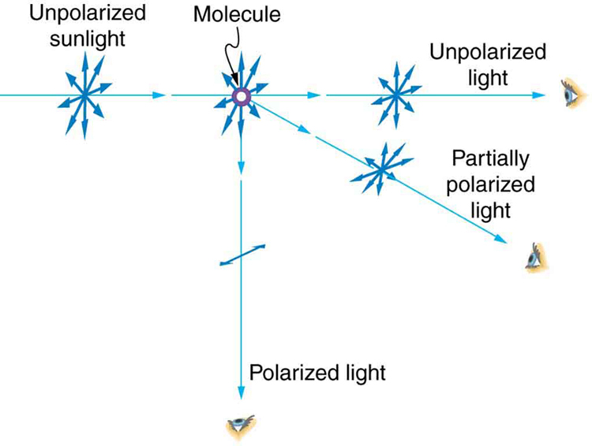
Wave Optics
Polarization by Scattering
Also known as Rayleigh scattering. Unpolarized light scattering from air molecules shakes their electrons perpendicular to the direction of the original ray. The scattered light therefore has a polarization perpendicular to the original direction and none parallel to the original direction.
Free to share, print, make copies and changes. Get yours at www.boundless.com
OpenStax CNX. "OpenStax College, Polarization. January 13, 2013." CC BY 3.0 http://cnx.org/content/m42522/latest/ View on Boundless.com

Slide 38
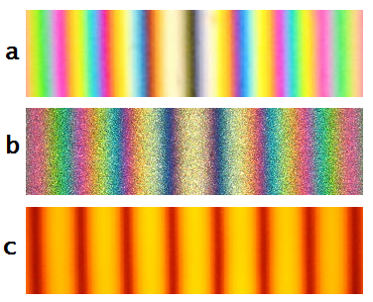
Wave Optics
Fringes in a Michelson Interferometer
Colored and monochromatic fringes in a Michelson interferometer: (a) White light fringes where the two beams differ in the number of phase inversions; (b) White light fringes where the two beams have experienced the same number of phase inversions; and (c) Fringe pattern using monochromatic light (sodium D lines).
Free to share, print, make copies and changes. Get yours at www.boundless.com
Wikimedia. CC BY-SA http://upload.wikimedia.org/wikipedia/en/d/dc/Colored_and_monochrome_fringes.png View on Boundless.com

Slide 39
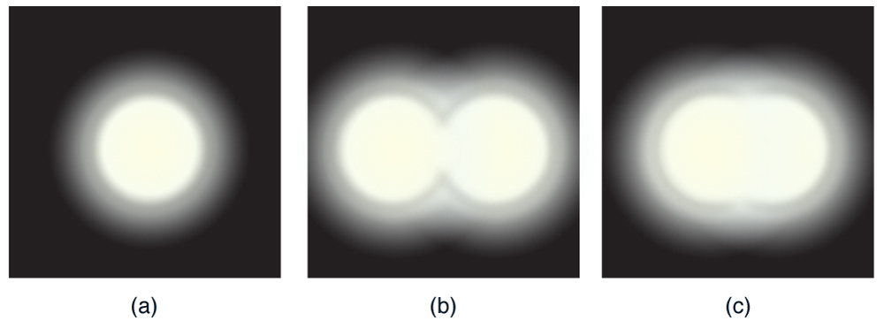
Wave Optics
Resolution Limits
(a) Monochromatic light passed through a small circular aperture produces this diffraction pattern. (b) Two point light sources that are close to one another produce overlapping images because of diffraction. (c) If they are closer together, they cannot be resolved or distinguished.
Free to share, print, make copies and changes. Get yours at www.boundless.com
OpenStax CNX. "OpenStax College, Limits of Resolution: The Rayleigh Criterion. January 11, 2013." CC BY 3.0 http://cnx.org/content/m42517/latest/ View on Boundless.com

Slide 40

Wave Optics
Sunset
A gradient of colors in the sky during sunset
Free to share, print, make copies and changes. Get yours at www.boundless.com
Wikipedia. "SDIM0241b." Public domain http://en.wikipedia.org/wiki/File:SDIM0241b.jpg View on Boundless.com

Slide 41
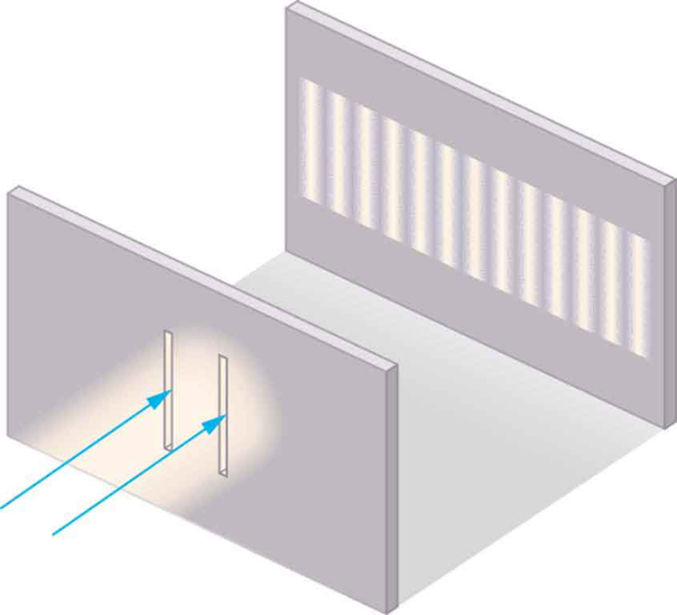
Wave Optics
Young's Double Slit Experiment
Light is sent through two vertical slits and is diffracted into a pattern of vertical lines spread out horizontally. Without diffraction and interference, the light would simply make two lines on the screen.
Free to share, print, make copies and changes. Get yours at www.boundless.com
OpenStax CNX. "OpenStax College, Young’s Double Slit Experiment. January 11, 2013." CC BY 3.0 http://cnx.org/content/m42508/latest/ View on Boundless.com

Slide 42
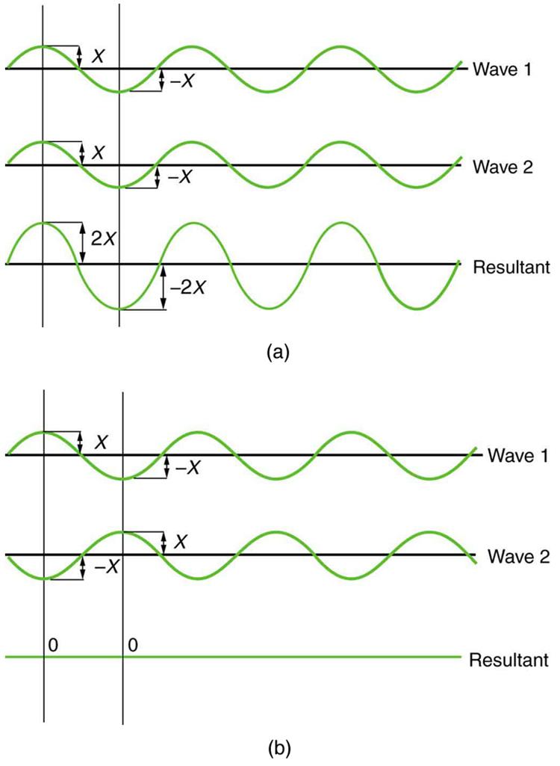
Wave Optics
Theoretical Constructive and Destructive Wave Interference
The amplitudes of waves add together. (a) Pure constructive interference is obtained when identical waves are in phase. (b) Pure destructive interference occurs when identical waves are exactly out of phase (shifted by half a wavelength).
Free to share, print, make copies and changes. Get yours at www.boundless.com
OpenStax CNX. "OpenStax College, Young’s Double Slit Experiment. January 11, 2013." CC BY 3.0 http://cnx.org/content/m42508/latest/ View on Boundless.com

Slide 43
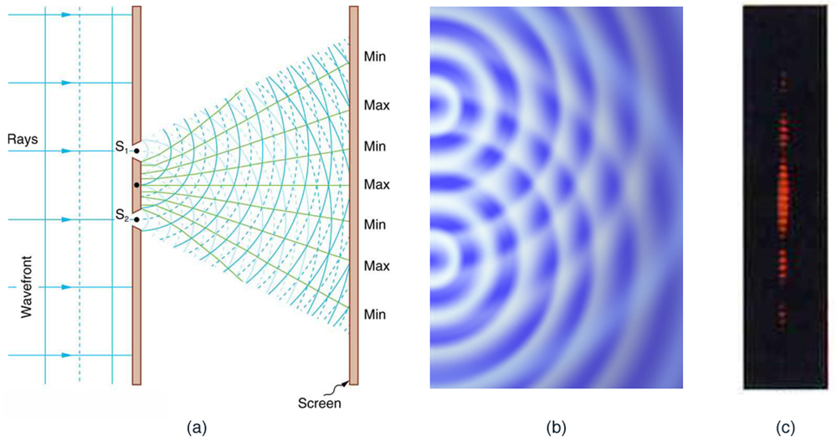
Wave Optics
Practical Constructive and Destructive Wave Interference
Double slits produce two coherent sources of waves that interfere. (a) Light spreads out (diffracts) from each slit because the slits are narrow. These waves overlap and interfere constructively (bright lines) and destructively (dark regions). We can only see this if the light falls onto a screen and is scattered into our eyes. (b) Double-slit interference pattern for water waves are nearly identical to that for light. Wave action is greatest in regions of constructive interference and least in regions of destructive interference. (c) When light that has passed through double slits falls on a screen, we see a pattern such as this.
Free to share, print, make copies and changes. Get yours at www.boundless.com
OpenStax CNX. "OpenStax College, Young’s Double Slit Experiment. January 11, 2013." CC BY 3.0 http://cnx.org/content/m42508/latest/ View on Boundless.com

Slide 44
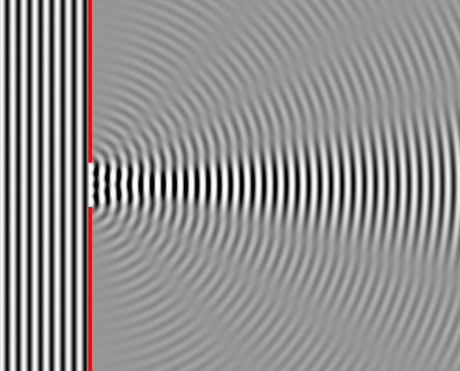
Wave Optics
Single Slit Diffraction - Four Wavelengths
This figure shows single slit diffraction, but the slit is the length of 4 wavelengths.
Free to share, print, make copies and changes. Get yours at www.boundless.com
Wikipedia. "Wave Diffraction 4Lambda Slit." Public domain http://en.wikipedia.org/wiki/File:Wave_Diffraction_4Lambda_Slit.png View on Boundless.com

Slide 45
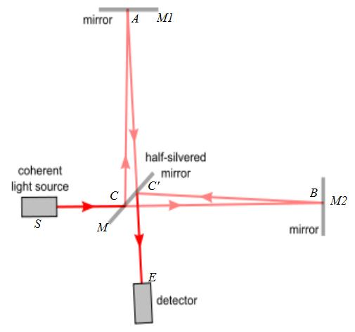
Wave Optics
Figure 3
This diagram of a Michelson Interferometer shows the path that the light waves travels in the instrument.
Free to share, print, make copies and changes. Get yours at www.boundless.com
Wikipedia. "Michaelson with letters." CC BY-SA http://en.wikipedia.org/wiki/File:Michaelson_with_letters.jpg View on Boundless.com

Slide 46
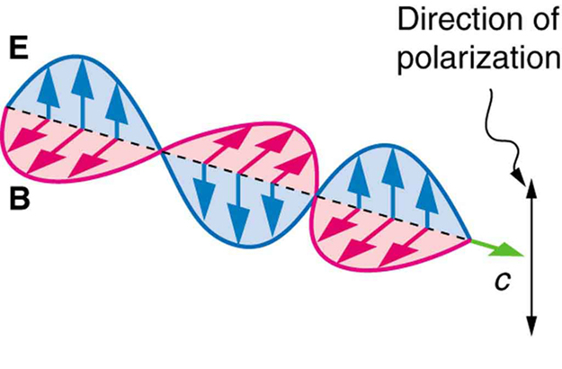
Wave Optics
Figure 2
An EM wave, such as light, is a transverse wave. The electric and magnetic fields are perpendicular to the direction of propagation.
Free to share, print, make copies and changes. Get yours at www.boundless.com
OpenStax CNX. "OpenStax College, Polarization. January 13, 2013." CC BY 3.0 http://cnx.org/content/m42522/latest/ View on Boundless.com

Slide 47
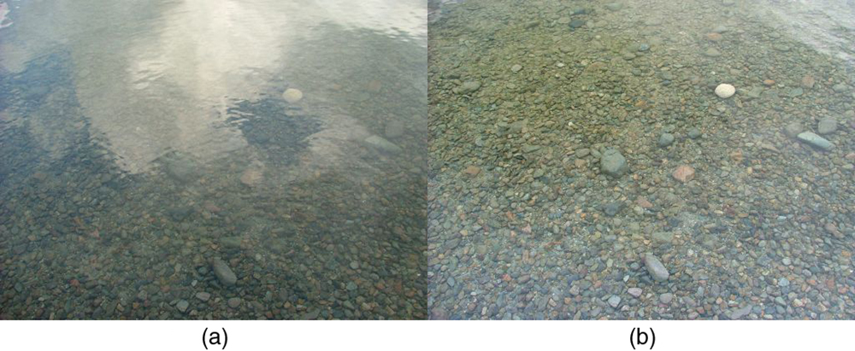
Wave Optics
Figure 4
These two photographs of a river show the effect of a polarizing filter in reducing glare in light reflected from the surface of water. Part (b) of this figure was taken with a polarizing filter and part (a) was not. As a result, the reflection of clouds and sky observed in part (a) is not observed in part (b). Polarizing sunglasses are particularly useful on snow and water. (credit: Amithshs, Wikimedia Commons)
Free to share, print, make copies and changes. Get yours at www.boundless.com
OpenStax CNX. "OpenStax College, Polarization. January 13, 2013." CC BY 3.0 http://cnx.org/content/m42522/latest/ View on Boundless.com

Slide 48
Wave Optics
Thin Film Interference
In this video I continue with my tutorials on Electromagnetism to Optics which is pitched at university undergraduate level. I have intended for a long time to record videos which describe the transition made from classical electromagnetism to optics. In many respects these videos will cover 'wave' optics. I devote much time to discussing the complex exponential representation of waves, Maxwell's Equations, the wave equation etc.Specifically here, I derive the formula for the optical path difference and the phase difference for a 'wave' of light propagating through a thin film. This expression can be used for anti reflective coatings. The phase difference is the product of the optical path differene and the wave vector k.I hope it's of use!! Thank you for watching and I hope that this matches your requirements.
Free to share, print, make copies and changes. Get yours at www.boundless.com
View on Boundless.com

Slide 49
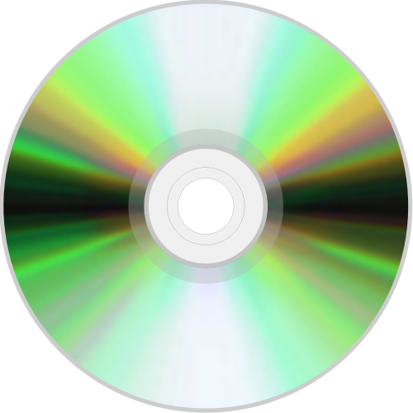
Wave Optics
Readable Surface of a CD
The readable surface of a Compact Disc includes a spiral track wound tightly enough to cause light to diffract into a full visible spectrum.
Free to share, print, make copies and changes. Get yours at www.boundless.com
Wikimedia. CC BY-SA http://upload.wikimedia.org/wikipedia/commons/thumb/d/d0/Compact_disc.svg/500px-Compact_disc.svg.png View on Boundless.com

Slide 50
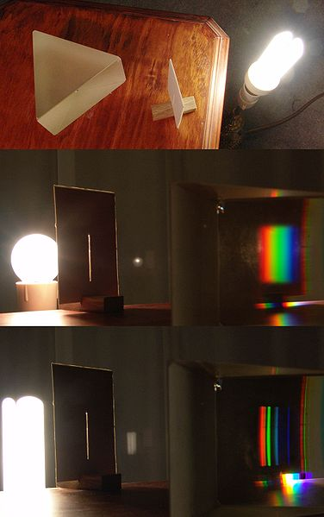
Wave Optics
A simple spectroscope
A very simple spectroscope based on a prism
Free to share, print, make copies and changes. Get yours at www.boundless.com
Wikipedia. "Simple spectroscope." CC BY-SA http://en.wikipedia.org/wiki/File:Simple_spectroscope.jpg View on Boundless.com

Slide 51
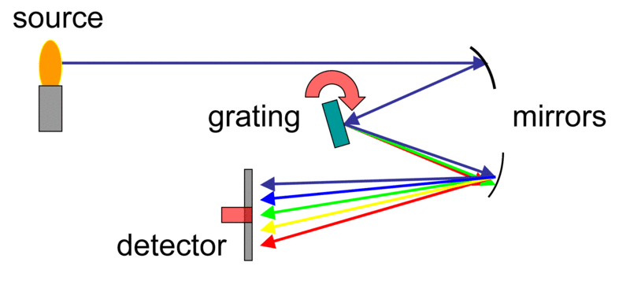
Wave Optics
Spectrometer Diagram
This diagram shows the light pathways in a spectrometer.
Free to share, print, make copies and changes. Get yours at www.boundless.com
Wikipedia. "Spectrometer schematic." GNU FDL http://en.wikipedia.org/wiki/File:Spectrometer_schematic.gif View on Boundless.com

Slide 52
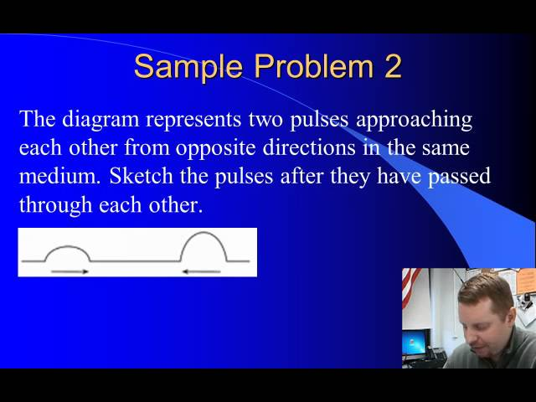
Wave Optics
Wave Interference
A brief introduction to constructive and destructive wave interference and the principle of superposition.
Free to share, print, make copies and changes. Get yours at www.boundless.com
View on Boundless.com

Slide 53
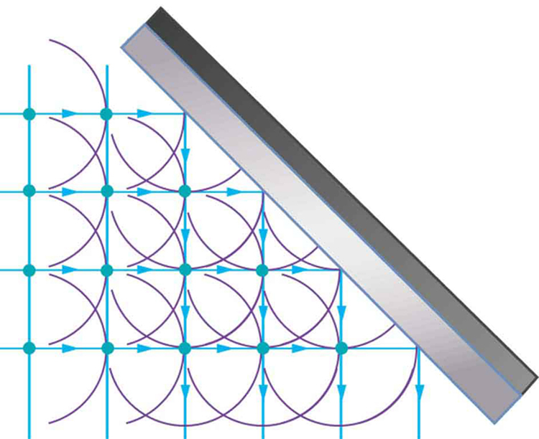
Wave Optics
Reflection
Huygens's principle applied to a straight wavefront striking a mirror. The wavelets shown were emitted as each point on the wavefront struck the mirror. The tangent to these wavelets shows that the new wavefront has been reflected at an angle equal to the incident angle. The direction of propagation is perpendicular to the wavefront, as shown by the downward-pointing arrows.
Free to share, print, make copies and changes. Get yours at www.boundless.com
OpenStax CNX. "OpenStax College, Huygens's Principle: Diffraction. January 11, 2013." CC BY 3.0 http://cnx.org/content/m42505/latest/ View on Boundless.com

Slide 54
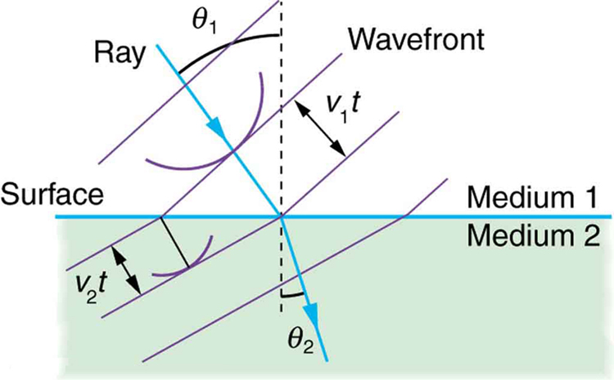
Wave Optics
Huygens's Refraction
Huygens's principle applied to a straight wavefront traveling from one medium to another where its speed is less. The ray bends toward the perpendicular, since the wavelets have a lower speed in the second medium.
Free to share, print, make copies and changes. Get yours at www.boundless.com
OpenStax CNX. "OpenStax College, Huygens's Principle: Diffraction. January 11, 2013." CC BY 3.0 http://cnx.org/content/m42505/latest/ View on Boundless.com

Slide 55
Wave Optics
Straight Wavefront
Huygens's principle applied to a straight wavefront. Each point on the wavefront emits a semicircular wavelet that moves a distance s=vt. The new wavefront is a line tangent to the wavelets.
Free to share, print, make copies and changes. Get yours at www.boundless.com
OpenStax CNX. "OpenStax College, Huygens's Principle: Diffraction. January 11, 2013." CC BY 3.0 http://cnx.org/content/m42505/latest/ View on Boundless.com

Slide 56
Attribution
Wave Optics
Wiktionary. "electromagnetic radiation." CC BY-SA 3.0 http://en.wiktionary.org/wiki/electromagnetic_radiation
Wiktionary. "polarizability." CC BY-SA 3.0 http://en.wiktionary.org/wiki/polarizability
Wikipedia. "Rayleigh light scattering." CC BY-SA 3.0 http://en.wikipedia.org/wiki/Rayleigh_light_scattering
Wiktionary. "diffraction." CC BY-SA 3.0 http://en.wiktionary.org/wiki/diffraction
Wikipedia. "Huygens–Fresnel principle." CC BY-SA 3.0 http://en.wikipedia.org/wiki/Huygens%E2%80%93Fresnel_principle
OpenStax CNX. "OpenStax College, Huygens's Principle: Diffraction. September 17, 2013." CC BY 3.0 http://cnx.org/content/m42505/latest/
Wiktionary. "nematic." CC BY-SA 3.0 http://en.wiktionary.org/wiki/nematic
Wiktionary. "helical." CC BY-SA 3.0 http://en.wiktionary.org/wiki/helical
Boundless Learning. "Boundless." CC BY-SA 3.0 http://www.boundless.com//physics/definition/lcd
Wikipedia. "Lcd." CC BY-SA 3.0 http://en.wikipedia.org/wiki/Lcd
Wikipedia. "plane wave." CC BY-SA 3.0 http://en.wikipedia.org/wiki/plane%20wave
Wiktionary. "coherent." CC BY-SA 3.0 http://en.wiktionary.org/wiki/coherent
OpenStax CNX. "OpenStax College, College Physics. September 17, 2013." CC BY 3.0 http://cnx.org/content/m42501/latest/?collection=col11406/1.7
Wikipedia. "Interference (wave propagation)." CC BY-SA 3.0 http://en.wikipedia.org/wiki/Interference_(wave_propagation)
OpenStax CNX. "OpenStax College, College Physics. September 17, 2013." CC BY 3.0 http://cnx.org/content/m42456/latest/?collection=col11406/1.7
Wiktionary. "resolution." CC BY-SA 3.0 http://en.wiktionary.org/wiki/resolution
Wiktionary. "diffraction." CC BY-SA 3.0 http://en.wiktionary.org/wiki/diffraction
Free to share, print, make copies and changes. Get yours at www.boundless.com

Slide 57
Wave Optics
Wikipedia. "Rayleigh criterion." CC BY-SA 3.0 http://en.wikipedia.org/wiki/Rayleigh_criterion%23Explanation
OpenStax CNX. "OpenStax College, Limits of Resolution: The Rayleigh Criterion. September 17, 2013." CC BY 3.0 http://cnx.org/content/m42517/latest/
Wiktionary. "contrast." CC BY-SA 3.0 http://en.wiktionary.org/wiki/contrast
Boundless Learning. "Boundless." CC BY-SA 3.0 http://www.boundless.com//physics/definition/microscopy
OpenStax CNX. "Melissa Dominguez, Sean McCudden, McKenzie Smith, and Kevin Kelly, Beyond Optical Microscopy. September 17, 2013." CC BY 3.0 http://cnx.org/content/m14353/latest/
Wikipedia. "Microscopy." CC BY-SA 3.0 http://en.wikipedia.org/wiki/Microscopy
Wiktionary. "polarization." CC BY-SA 3.0 http://en.wiktionary.org/wiki/polarization
Wiktionary. "index of refraction." CC BY-SA 3.0 http://en.wiktionary.org/wiki/index+of+refraction
OpenStax CNX. "OpenStax College, Polarization. September 17, 2013." CC BY 3.0 http://cnx.org/content/m42522/latest/
Wiktionary. "dispersion." CC BY-SA 3.0 http://en.wiktionary.org/wiki/dispersion
Wiktionary. "reflection." CC BY-SA 3.0 http://en.wiktionary.org/wiki/reflection
Boundless Learning. "Boundless." CC BY-SA 3.0 http://www.boundless.com//physics/definition/refraction
Wikipedia. "Visible spectrum." CC BY-SA 3.0 http://en.wikipedia.org/wiki/Visible_spectrum
OpenStax CNX. "OpenStax College, Dispersion: The Rainbow and Prisms. September 17, 2013." CC BY 3.0 http://cnx.org/content/m42466/latest/
Wiktionary. "incandescence." CC BY-SA 3.0 http://en.wiktionary.org/wiki/incandescence
Wikipedia. "Spectrometer." CC BY-SA 3.0 http://en.wikipedia.org/wiki/Spectrometer
Wikipedia. "Spectroscopic analysis." CC BY-SA 3.0 http://en.wikipedia.org/wiki/Spectroscopic_analysis
Boundless Learning. "Boundless." CC BY-SA 3.0 http://www.boundless.com//physics/definition/monochromatic
Wiktionary. "lens." CC BY-SA 3.0 http://en.wiktionary.org/wiki/lens
Free to share, print, make copies and changes. Get yours at www.boundless.com

Slide 58
Wave Optics
Wiktionary. "wavelength." CC BY-SA 3.0 http://en.wiktionary.org/wiki/wavelength
Wikipedia. "Newton's rings." CC BY-SA 3.0 http://en.wikipedia.org/wiki/Newton's_rings
Wikipedia. "binary data." CC BY-SA 3.0 http://en.wikipedia.org/wiki/binary%20data
Boundless Learning. "Boundless." CC BY-SA 3.0 http://www.boundless.com//physics/definition/land
Boundless Learning. "Boundless." CC BY-SA 3.0 http://www.boundless.com//physics/definition/pit
Wikipedia. "CD-ROM." CC BY-SA 3.0 http://en.wikipedia.org/wiki/CD-ROM
Wikipedia. "Optical disc." CC BY-SA 3.0 http://en.wikipedia.org/wiki/Optical_disc
Wiktionary. "wavelength." CC BY-SA 3.0 http://en.wiktionary.org/wiki/wavelength
Wiktionary. "interference." CC BY-SA 3.0 http://en.wiktionary.org/wiki/interference
Wikipedia. "incident ray." CC BY-SA 3.0 http://en.wikipedia.org/wiki/incident%20ray
OpenStax CNX. "OpenStax College, Thin Film Interference. September 17, 2013." CC BY 3.0 http://cnx.org/content/m42519/latest/
Wikipedia. "Thin film interference." CC BY-SA 3.0 http://en.wikipedia.org/wiki/Thin_film_interference
Wikipedia. "Thin film interference." CC BY-SA 3.0 http://en.wikipedia.org/wiki/Thin_film_interference
OpenStax CNX. "Paul Padley, Thin Film Interference. September 17, 2013." CC BY 3.0 http://cnx.org/content/m12910/latest/
Wiktionary. "interferometer." CC BY-SA 3.0 http://en.wiktionary.org/wiki/interferometer
Wiktionary. "orthogonal." CC BY-SA 3.0 http://en.wiktionary.org/wiki/orthogonal
Wikipedia. "Air-wedge shearing interferometer." CC BY-SA 3.0 http://en.wikipedia.org/wiki/Air-wedge_shearing_interferometer
Boundless Learning. "Boundless." CC BY-SA 3.0 http://www.boundless.com//physics/definition/destructive-interference
Boundless Learning. "Boundless." CC BY-SA 3.0 http://www.boundless.com//physics/definition/constructive-interference
Free to share, print, make copies and changes. Get yours at www.boundless.com

Slide 59
Wave Optics
Wikipedia. "Youngs double-slit experiment." CC BY-SA 3.0 http://en.wikipedia.org/wiki/Youngs_double-slit_experiment
OpenStax CNX. "OpenStax College, Young’s Double Slit Experiment. September 18, 2013." CC BY 3.0 http://cnx.org/content/m42508/latest/
Boundless Learning. "Boundless." CC BY-SA 3.0 http://www.boundless.com//physics/definition/monochromatic
Wiktionary. "diffraction." CC BY-SA 3.0 http://en.wiktionary.org/wiki/diffraction
Wikipedia. "Single slit diffraction." CC BY-SA 3.0 http://en.wikipedia.org/wiki/Single_slit_diffraction%23Single-slit_diffraction
OpenStax CNX. "Paul Padley, Single Slit Diffraction. September 18, 2013." CC BY 3.0 http://cnx.org/content/m12915/latest/
Wiktionary. "oscillate." CC BY-SA 3.0 http://en.wiktionary.org/wiki/oscillate
Wikipedia. "Polarization (waves)." CC BY-SA 3.0 http://en.wikipedia.org/wiki/Polarization_(waves)
OpenStax CNX. "OpenStax College, Polarization. September 18, 2013." CC BY 3.0 http://cnx.org/content/m42522/latest/
Wiktionary. "diffraction." CC BY-SA 3.0 http://en.wiktionary.org/wiki/diffraction
Wiktionary. "iridescence." CC BY-SA 3.0 http://en.wiktionary.org/wiki/iridescence
Wiktionary. "interference." CC BY-SA 3.0 http://en.wiktionary.org/wiki/interference
OpenStax CNX. "OpenStax College, Multiple Slit Diffraction. September 18, 2013." CC BY 3.0 http://cnx.org/content/m42512/latest/
Wikipedia. "Diffraction." CC BY-SA 3.0 http://en.wikipedia.org/wiki/Diffraction%23Diffraction_grating
Wikipedia. "Iridescent." CC BY-SA 3.0 http://en.wikipedia.org/wiki/Iridescent
Wikipedia. "X-rays." CC BY-SA 3.0 http://en.wikipedia.org/wiki/X-rays
Wikipedia. "X-ray crystallography." CC BY-SA 3.0 http://en.wikipedia.org/wiki/X-ray_crystallography
Wikipedia. "Diffraction grating." CC BY-SA 3.0 http://en.wikipedia.org/wiki/Diffraction_grating
Wikipedia. "Diffraction grating." CC BY-SA 3.0 http://en.wikipedia.org/wiki/Diffraction_grating%23Natural_gratings
Free to share, print, make copies and changes. Get yours at www.boundless.com

Slide 60
Wave Optics
Wikipedia. "X-ray diffraction." CC BY-SA 3.0 http://en.wikipedia.org/wiki/X-ray_diffraction
Wiktionary. "special relativity." CC BY-SA 3.0 http://en.wiktionary.org/wiki/special_relativity
Wiktionary. "interference." CC BY-SA 3.0 http://en.wiktionary.org/wiki/interference
Wiktionary. "superimposed." CC BY-SA 3.0 http://en.wiktionary.org/wiki/superimposed
Wikipedia. "Interferometry." CC BY-SA 3.0 http://en.wikipedia.org/wiki/Interferometry
Wikipedia. "Michelson interferometer." CC BY-SA 3.0 http://en.wikipedia.org/wiki/Michelson_interferometer
Free to share, print, make copies and changes. Get yours at www.boundless.com

